Slide 1
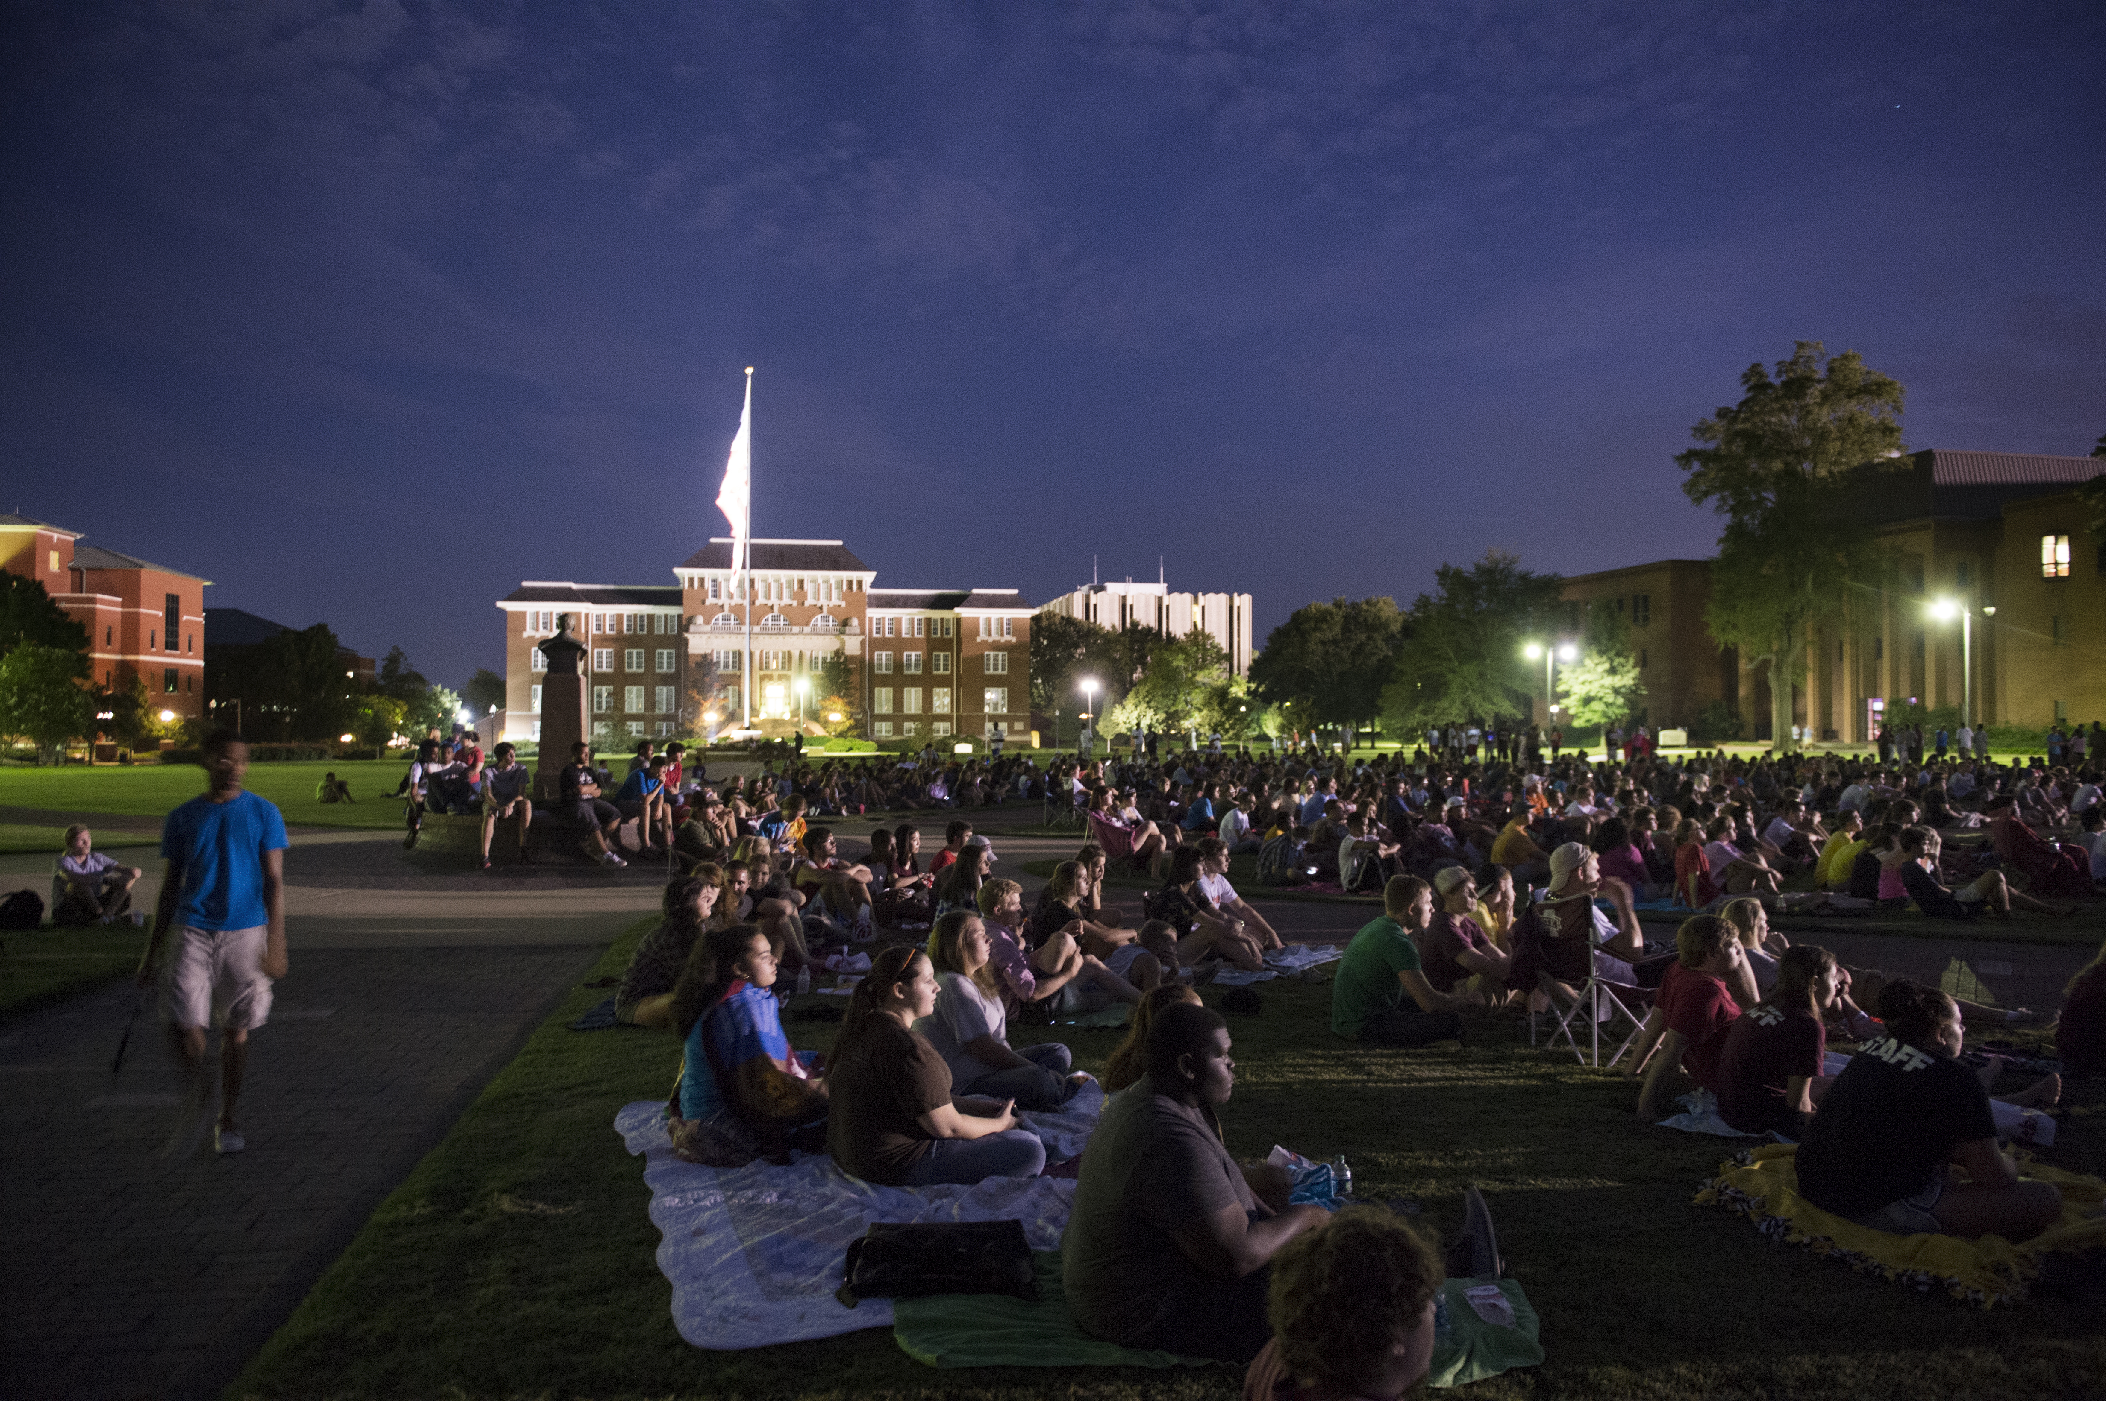
STUDENT ACTIVITIES Mississippi State University
Orientation 2018

Slide 2
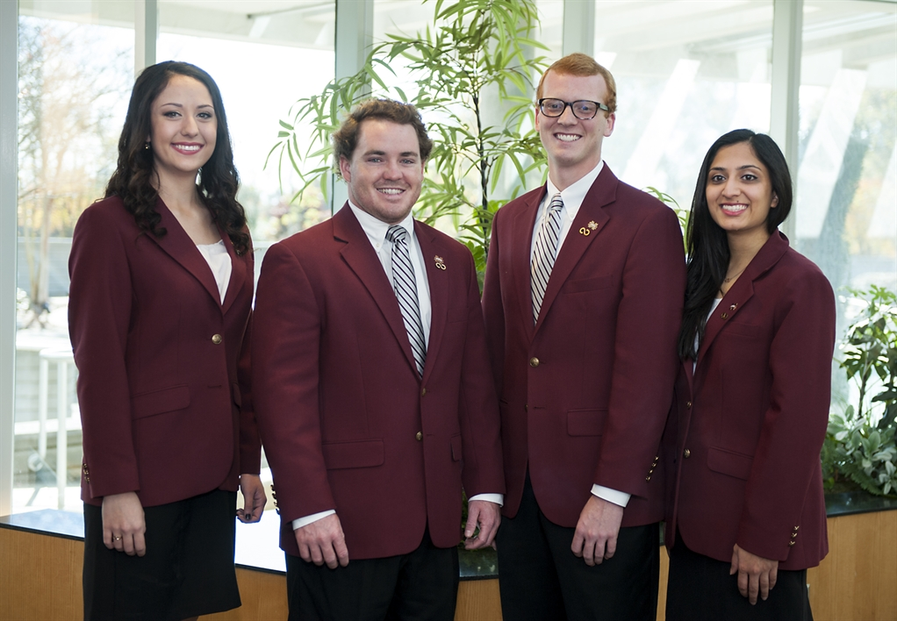
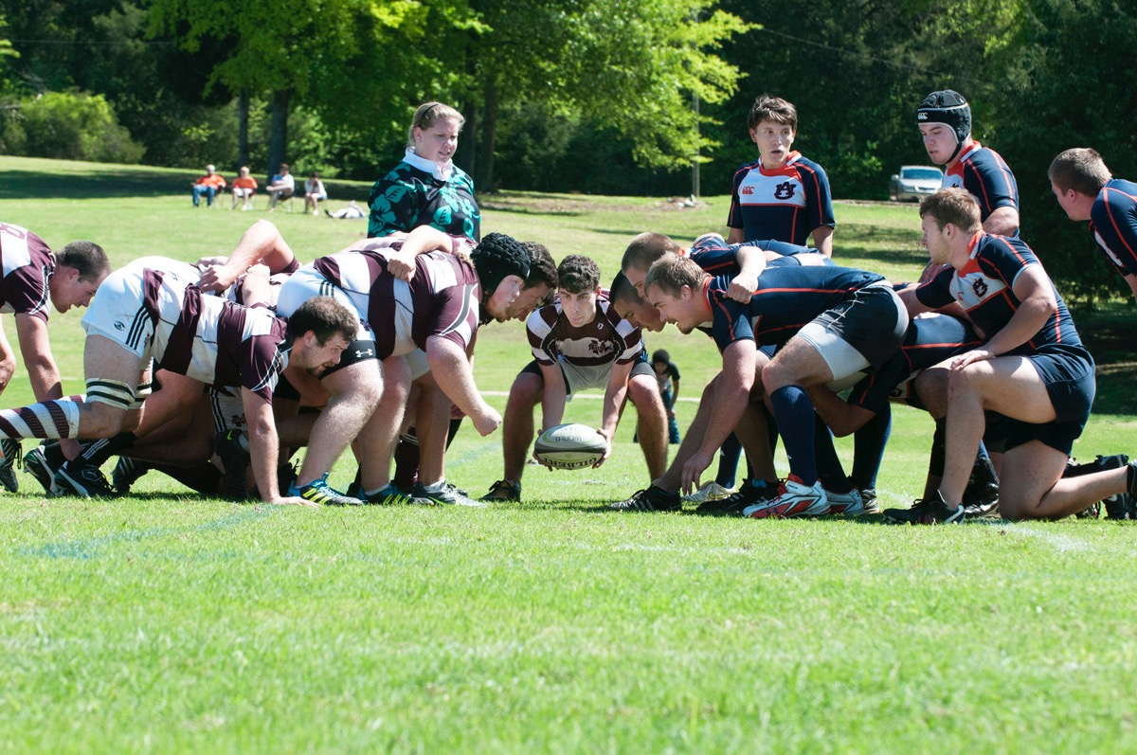
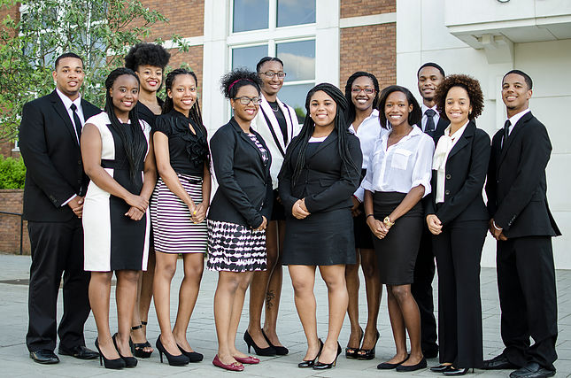
MSU Student Organizations
Difference of One:
385+ Student Organizations
OrgSync
Cultural
Faith-Based
Honorary
Performing Arts
Political
Professional
Recreational
Service
Special Interest
Departmental/University
Other

Slide 3
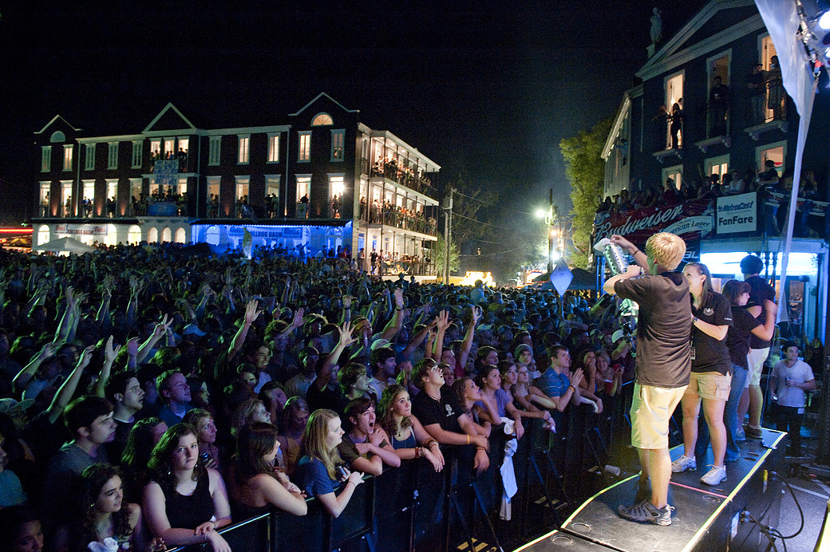
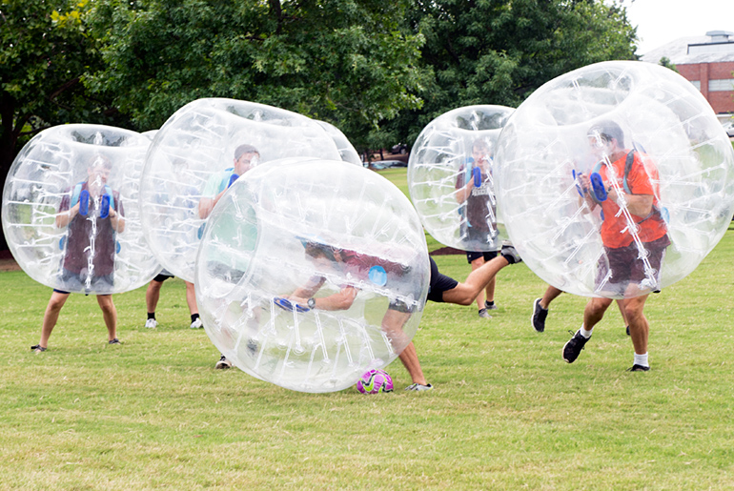
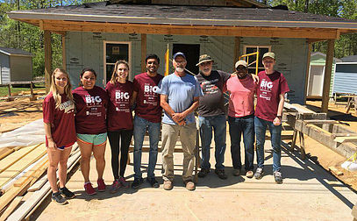
Student Association
Executive Council
Attend meetings to advocate for students
Liaison between students and administration
Elected each Spring
Cabinet
Bulldog Bash, Costume Carnival,
Late Night Events, Cowbell Cabs,
Finish in 4, and Block by Block
Senate
Pass legislation representing the students’ voice
Appropriate over $55,000 for student organizations
www.sa.msstate.edu

Slide 4
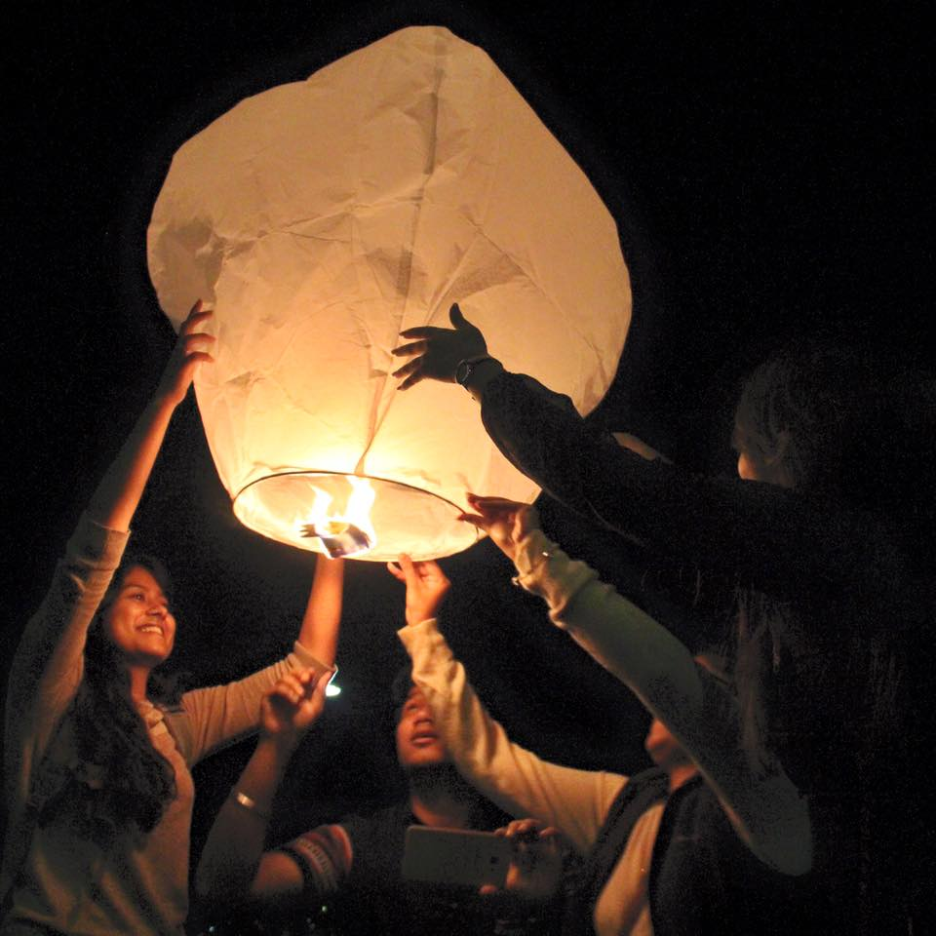
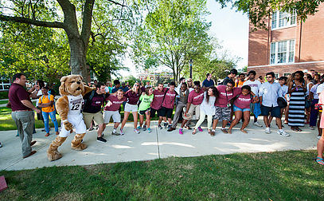
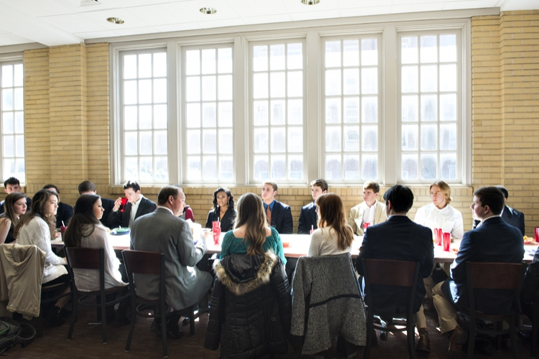
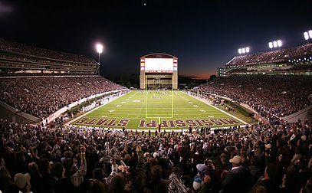
Student Association
Freshmen Senators
Five elected each Fall
Freshman Forum
Plan and host a conference for high
school seniors each February
Freshman Council
Plan events and implement policies that
improve the Freshman Experience
Freshman Edge
Plan community service events
throughout the year
www.sa.msstate.edu

Slide 5
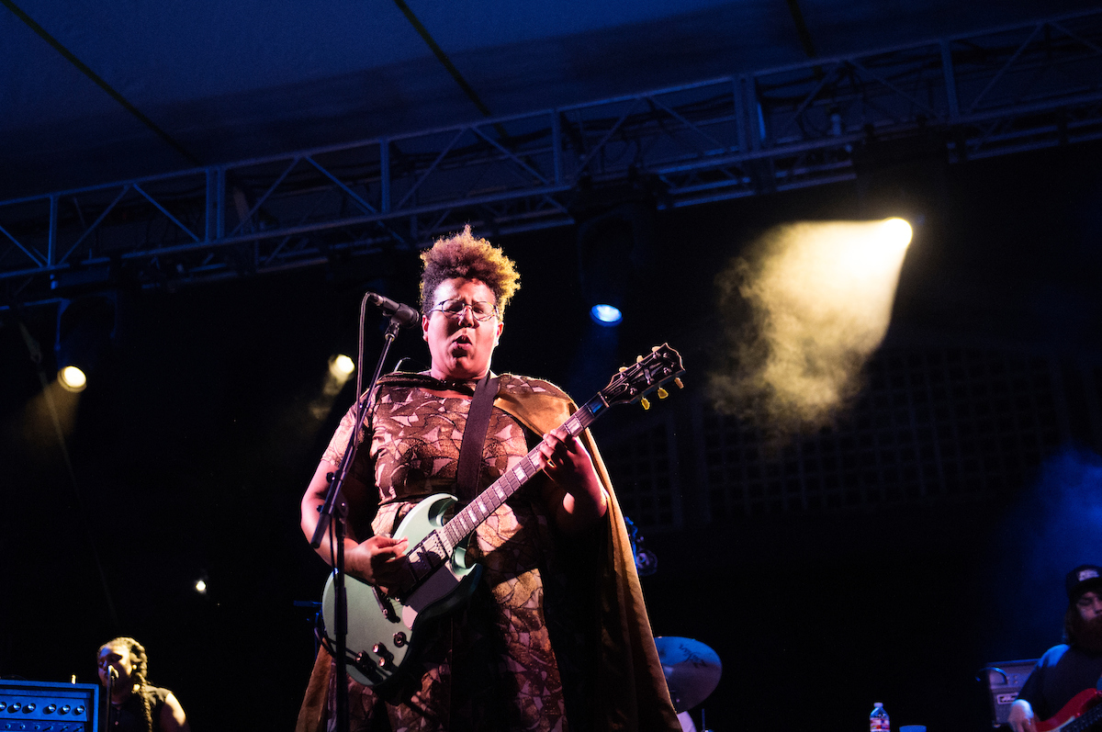
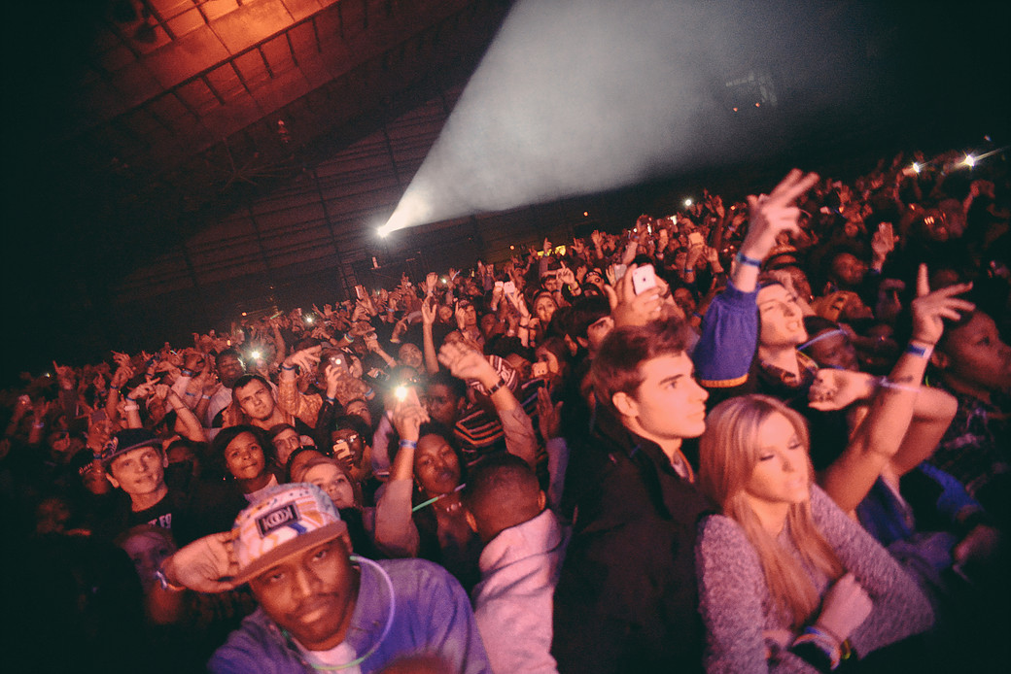
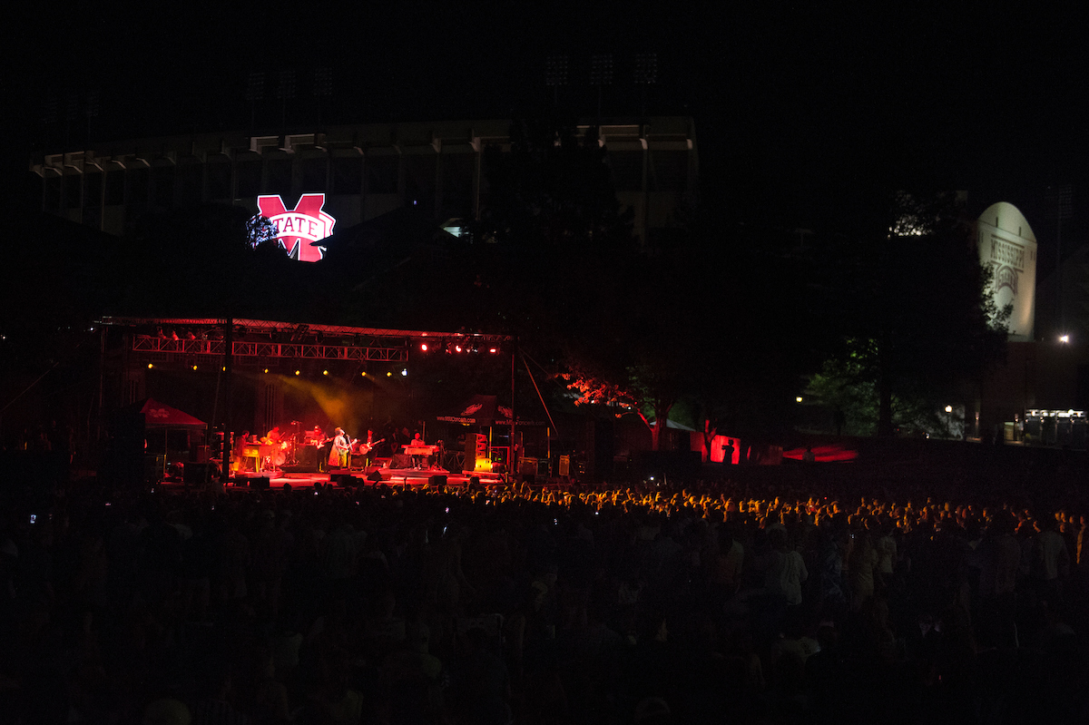
Music Makers Production
Student-run concert production organization
Concerts for national and local acts
Past Performers:
Zac Brown Band, NEEDTOBREATHE,
Alabama Shakes, 2Chainz, Jack White,
Rae Sremmurd, and Ben Rector
www.msuconcerts.com

Slide 6
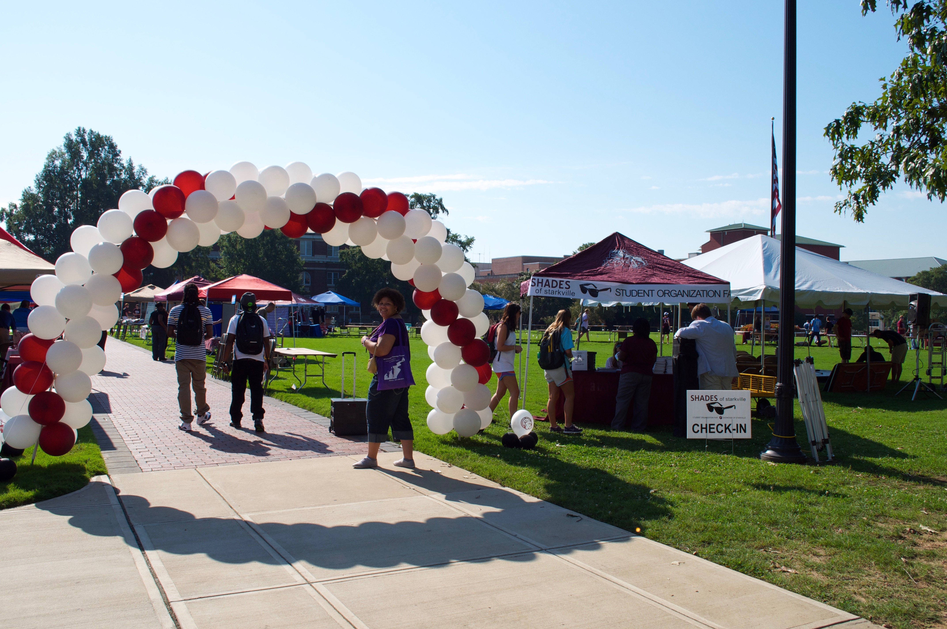
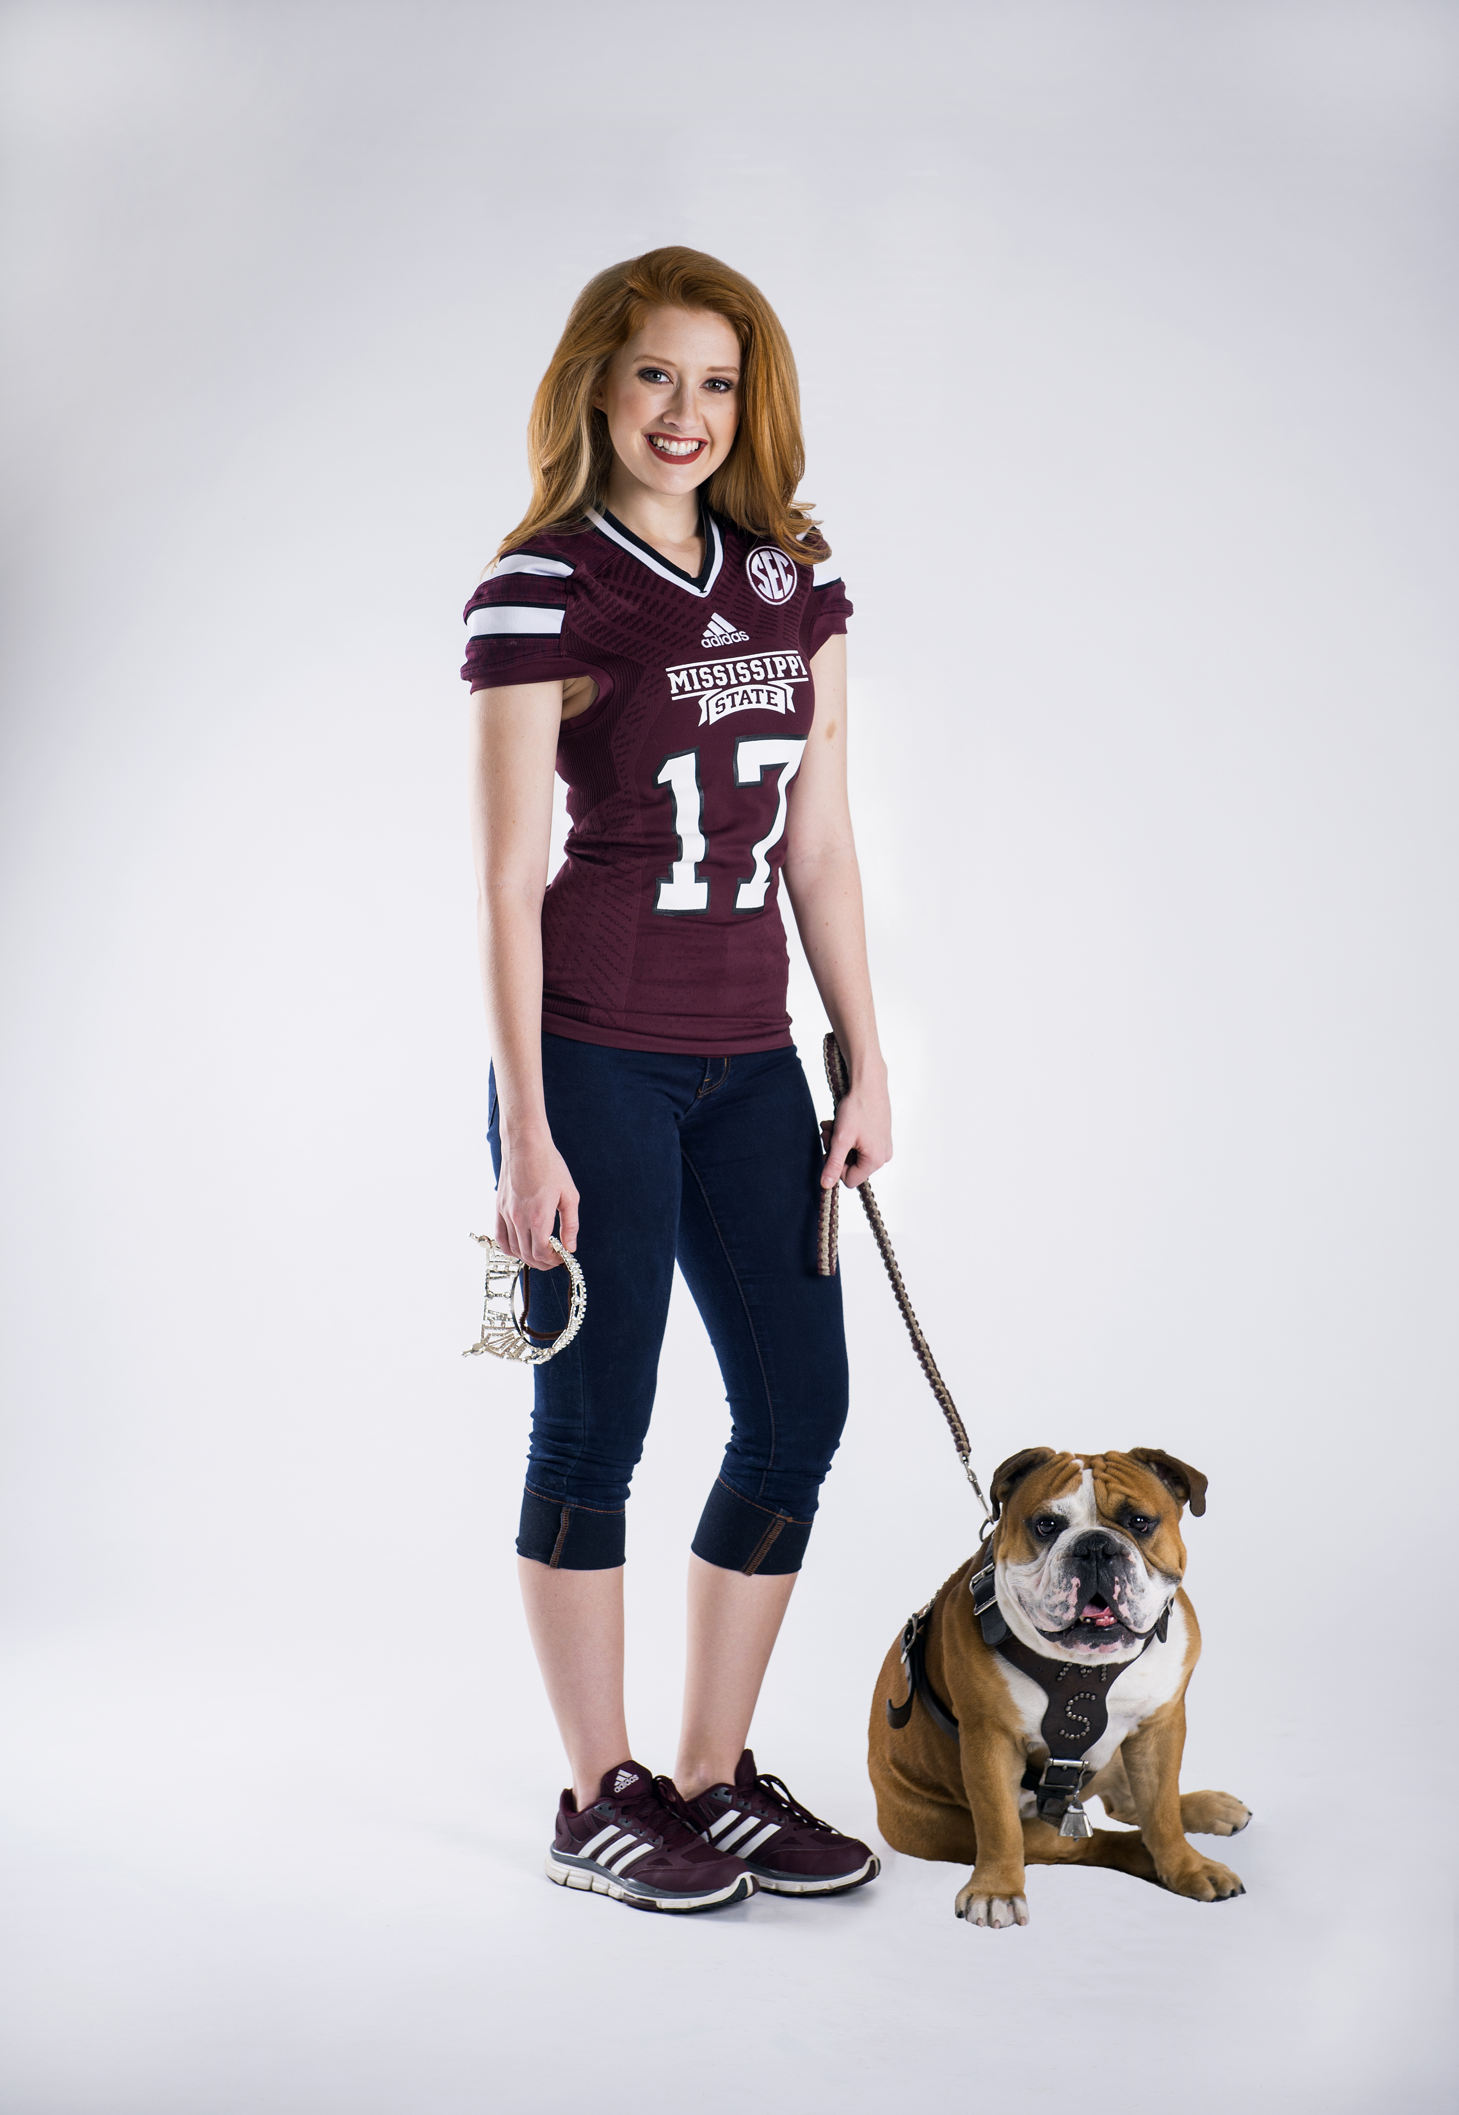
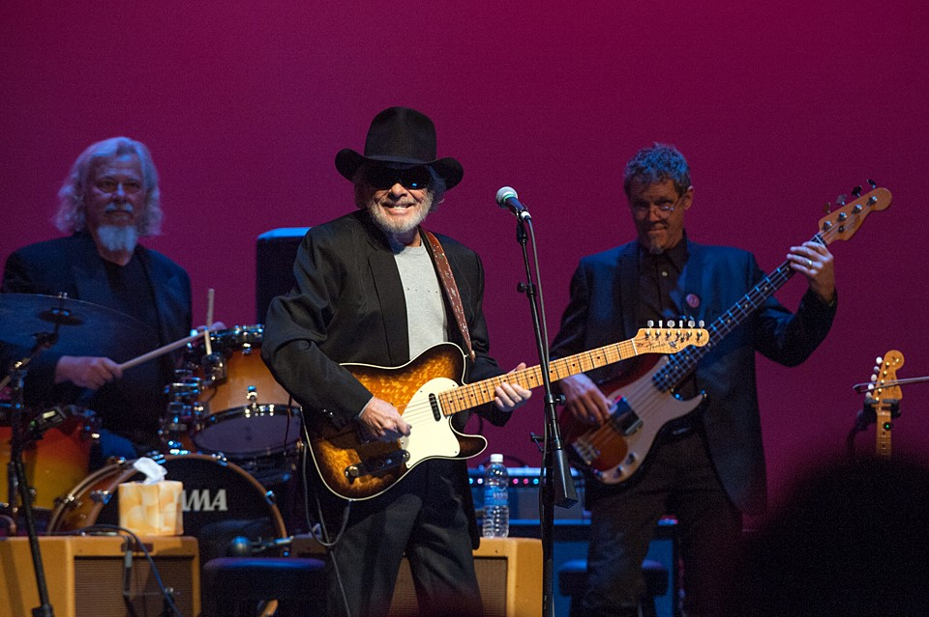
Center for Student Activities
Involvement Ambassadors
Dawg Days
Shades of Starkville
Miss MSU and
Miss Maroon & White Pageants
Dance Marathon
Union Art Gallery
Lyceum Series

Slide 7
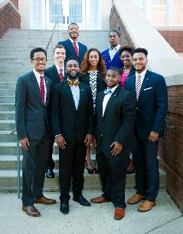
MSU Fraternities & Sororities
Four Councils include:
Interfraternity Council
Panhellenic Council
National Pan-Hellenic Council
Multicultural Greek Council

Slide 8
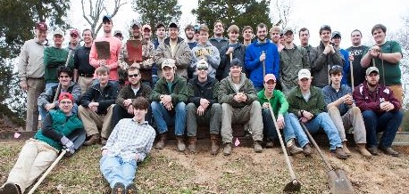
Benefits of a Greek Organization
Support Group
Networking
Academics
Involvement
Social Engagement
Philanthropy & Community Service

Slide 9
How does IFC recruitment work?
Sunday, August 19th
Tabling: 9:30 AM - 12:30 PM
-Humphrey Coliseum
-Attire: Collared Shirt, Dress Pants/Slacks
Open House: 4:30 PM - 8:30 PM
-Amphitheater/Fraternity and Sorority Row
-Attire: Khaki Shorts, T-Shirt/Golf Polo
PNMs select 10 Chapters
Monday, August 20th
Chapter Visits: 10 Rounds, 40 Minutes Each
-9:00 AM - 6:30 PM
-Attire: Khaki Shorts, T-Shirt/Golf Polo
PNMs select 6 Chapters
Tuesday, August 21st
Recreation Day: 6 Rounds, 3:00 PM - 9:00 PM
Attire: Sportswear, Shorts, T-Shirt
PNMs select 3 Chapters
Wednesday, August 22nd
Food & Suit Night: 3 Rounds, 6:00 PM - 9:00 PM
Attire: Suit and Tie
PNMs select final chapter
Thursday, August 23rd
Bid Signing: Bids signed by 3:00 PM on CampusDirector
Bid Day Presentation: Lee Hall, Bettersworth Auditorium-4:00 PM

Slide 10
How does Panhellenic recruitment work?
Sunday, August 12th
Panhellenic Sorority Recruitment Move-In Day
Optional Parent Orientation at 3 PM
MANDATORY Student Orientation from 5-7 PM for every student registered in Union Ballroom
Sunday, August 12th
Go Greek Day
Monday, August 13th
Go Greek Day
Tuesday, August 15th
Philanthropy Day
Wednesday, August 16th
Sisterhood Day
Thursday, August 16th
Preference Day
Friday, August 18th
Bid Day!
You should plan on devoting all day during these days to recruitment. A more detailed schedule is available on our website www.greeks.msstate.edu

Slide 11
National Pan-Hellenic Council Intake
Step 1
Research & attend Meet the Greeks at 5PM-7PM August 24th
Step 2
Attend the NPHC Informational on August 26th
Bettersworth Auditorium – Lee Hall
Step 3
Interest Meeting & Rush
Step 4
Membership Intake or Membership Recruitment

Slide 12
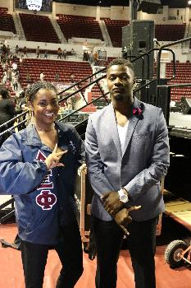
Multicultural Greek Council
Step 1
Attend the MGC Informational on August 28th
Step 2
Interest Meeting & Rush
Step 3
Membership Intake
or Membership Recruitment

Slide 13
Academic Requirements for Recruitment & Intake
Interfraternity Council
2.75 to participate in IFC Fraternity Recruitment
Panhellenic Council
Please see scale in FAQ Document in folder.
National Pan-Hellenic Council
At least 12 credit hours at Mississippi State
2.5 GPA or higher
Multicultural Greek Council
2.5 GPA or higher

Slide 14
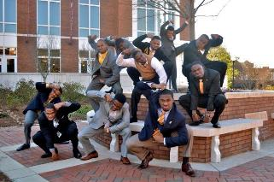
Academic, Scholarships & Grades
Please see
the scorecards
in folder & at www.greeks.msstate.edu.

Slide 15
Fees & Cost
IFC Chapters
$100 Recruitment Registration Fee
Range from $500 - $2,000 per semester
Panhellenic Chapters
$125 Recruitment Registration Fee
Range from $3,500 – $5,000 per semester
National Pan-Hellenic Chapters
Average - $300 per semester
Multicultural Greek Chapters
Average - $300 per chapters

Slide 16
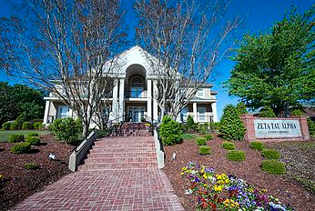
Housing & Meal Plan Options
12 IFC fraternities have a chapter
house and meal places
8 Panhellenic sororities have a chapter
house and meal places
All Freshmen are required to purchase a meal plan with MSU Dining services. There is a Greek Meal plan available once a bid is accepted. This must be done in person. August 31st is the deadline to change to Greek Meal Plan. For more information please visit: www.dining.msstate.edu

Slide 17
The Role of Parents
There are never too many questions.
There are never bad questions.
Ask for updates from your student.
Get involved with Parents Clubs and organizations.
Have discussions with your student prior to recruitment.
Communicate with MSU issues or concerns with your student’s experience.

Slide 18
Questions to Ask
How much are dues?
What is the time commitment?
Does the chapter have any recent Code of Conduct issues?
How does your chapter support its members academically?
What is your pledging/new member experience like?
Will I have to live in the house?
Is there a meal plan? Is it mandatory?
What are your philanthropy and community service projects? How is each member involved?
What type of social functions does the chapter host?

Slide 19
What’s next?
Do your Research!
If you are interested in a chapter reach out to the recruitment chair or chapter officer.
IFC
Register for Recruitment – Deadline is
August 18th at 11:59 PM.
Panhellenic
Register for Recruitment – Deadline is
July 31st at 11:59 PM.
NPHC
Attend the NPHC Informational Meeting & Meet the Greeks.
MGC
Attend the Informational Session.

Slide 20
Contact Information
Jackie Mullen
Panhellenic Advisor
jmullen@saffairs.msstate.edu
John Michael Vanhorn
Interfraternity Council Advisor
jvanhorn@saffars.msstate.edu
ShirDonna Lawrence
National PanHellenic Council Advisor
s.lawrence@saffairs.msstate.edu
Phone: 662-325-3917

Slide 21
Follow Us on Social Media
MSU_IFC
msu_panhellenic
NPHC_mstate
msstate_MGC
www.greeks.msstate.edu

